Slide 1


SKILLSYNC AI
An Intelligent Data Engineering Platform for
Real-Time Job Market & Emerging Skill Intelligence
FUNDAMENTALS OF DATA ENGINEERING FOR AI
Team Members:
2420090087 – V Akshaya 2420030753 - Sudhamsha A 2420030619 - Tanishka
Guide: Dr.N.Shirisha Associate Professor
REVIEW 1 & 2

Slide 2

PROJECT OVERVIEW
SkillSync AI is an intelligent data engineering platform designed to transform continuously evolving job-market data into actionable skill intelligence. The platform integrates heterogeneous job data from multiple sources using batch and real-time streaming ingestion, followed by automated data-quality validation, deduplication, standardization, and scalable processing using PySpark. Natural Language Processing (NLP) techniques are applied to unstructured job descriptions to extract, normalize, and categorize relevant skills. The processed data enables job-market analytics, emerging-skill detection, role-based skill-gap analysis, and machine-learning-based demand forecasting. By combining Data Engineering, NLP, Machine Learning, and analytics, SkillSync AI provides a scalable end-to-end solution for converting raw job-market data into reliable insights and decision-ready intelligence.

Slide 3
METHODOLOGY
METHODOLOGY | DESCRIPTION
Data Collection | Collect job-market data from multiple sources CSV / JSON / API-based data
Data Ingestion | Batch and streaming ingestion
Data Preprocessing | Data validation Cleaning Deduplication Standardization
Skill Extraction | NLP-based extraction from job descriptions Skill normalization and categorization
Data Analytics | Skill frequency Role-wise skill analysis Emerging skill detection
Prediction | Analyze historical trends Forecast future skill demand
Visualization | Dashboard-based decision support

Slide 4
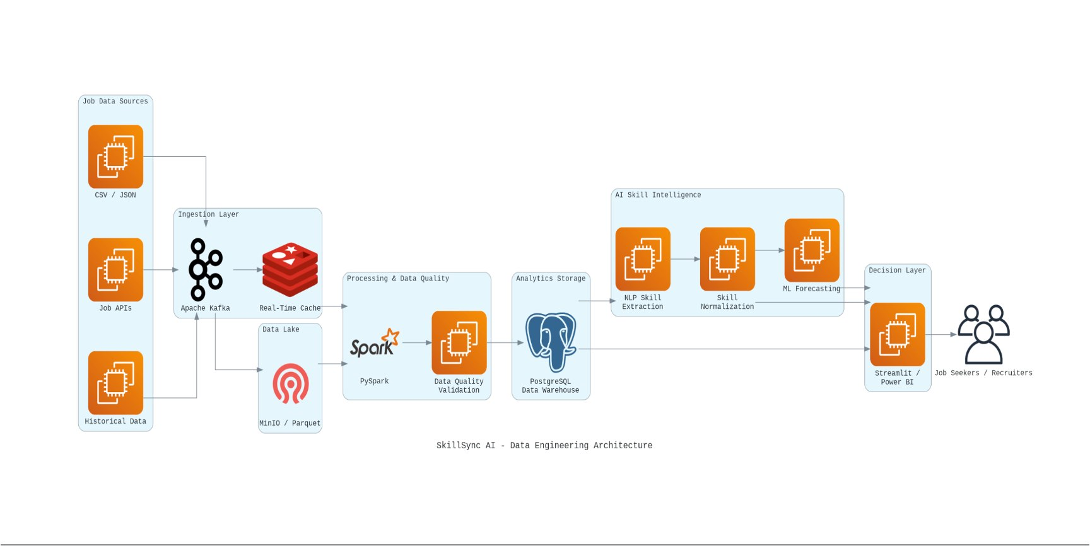
SYSTEM ARCHITECTURE

Slide 5
TECHNOLOGY STACK
CATEGORY | TECH STACK
Programming | Python
Data Engineering | Apache Spark ,PySpark ,Apache Kafka
Data Storage | MinIO, Apache Parquet, PostgreSQL
Data Quality | Great Expectations
AI / NLP | spaCy, Transformers / LLM
Machine Learning | Scikit-learn
Orchestration | Apache Airflow
Visualization | Streamlit, Power BI
Deployment | Docker

Slide 6
DATA ENGINEERING PIPELINE
Source Data
↓
Ingestion
↓
Validation
↓
Cleaning
↓
Deduplication
↓
Transformation
↓
Parquet / Data Lake
↓
PostgreSQL
Key implementation features:
Automated data cleaning
Schema standardization
Duplicate detection
Missing-value handling
Scalable processing using PySpark

Slide 7
IMPLEMENTATION
01 Data Processing
Python + PySpark used for data transformation.
02 Skill Extraction
NLP processes job descriptions and identifies relevant skills.
03 Skill Normalization
Different representations of the same skill are standardized.
04 Analytics
Processed data is used to identify skill-demand patterns.
05 Forecasting
Historical trends are used to estimate future demand.
06 Dashboard
Insights are presented through an interactive interface.

Slide 8
CODING QUALITY
CODING QUALITY & BEST PRACTICES
Modular code structure
Reusable functions
Meaningful variable and function names
Proper exception handling
Input validation
Separation of data-processing and application logic
Consistent coding standards
Comments for important processing steps
Version control using Git

Slide 9
FUNCTIONALITIES
SKILLSYNC AI — FUNCTIONALITIES
Job data ingestion
Data validation
Data cleaning
Duplicate removal
Data transformation
Skill extraction
Skill normalization
Skill categorization
Skill-demand analysis
Emerging skill identification
Demand forecasting
Interactive visualization

Slide 10
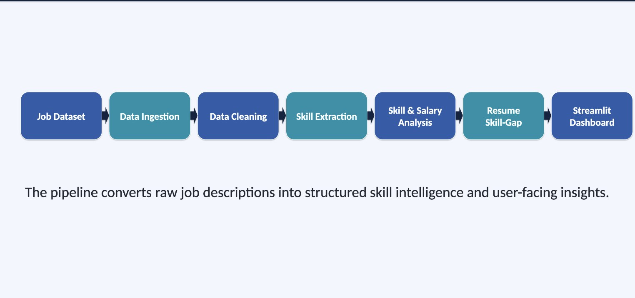
PROJECT WORKFLOW

Slide 11
THANK YOU
SkillSync AI • Fundamentals of Data Engineering for AI

